Slide 1
Rendering Curves and Surfaces
Ed Angel
Professor of Computer Science, Electrical and Computer Engineering, and Media Arts
University of New Mexico
Angel: Interactive Computer Graphics 5E © Addison-Wesley 2009

Slide 2
Objectives
Introduce methods to draw curves
  Approximate with lines
  Finite Differences
Derive the recursive method for evaluation of Bezier curves and surfaces
Learn how to convert all polynomial data to data for Bezier polynomials
Angel: Interactive Computer Graphics 5E © Addison-Wesley 2009

Slide 3
Evaluating Polynomials
Simplest method to render a polynomial curve is to evaluate the polynomial at many points and form an approximating polyline
For surfaces we can form an approximating mesh of triangles or quadrilaterals
Use Horner’s method to evaluate polynomials
  p(u)=c₀+u(c₁+u(c₂+uc₃))
  3 multiplications/evaluation for cubic
Angel: Interactive Computer Graphics 5E © Addison-Wesley 2009

Slide 4
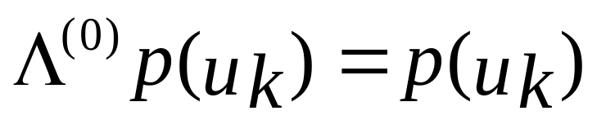
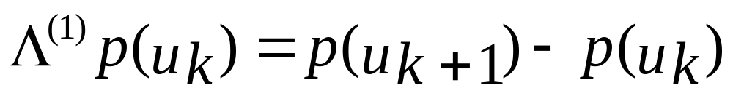
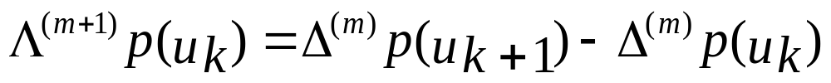
Finite Differences
For equally spaced {u_{k}} we define finite differences
For a polynomial of degree n,
the n^{th} finite difference is constant
Angel: Interactive Computer Graphics 5E © Addison-Wesley 2009

Slide 5
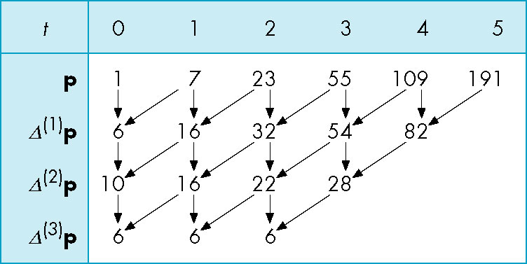
Building a Finite Difference Table
p(u)=1+3u+2u²+u³
Angel: Interactive Computer Graphics 5E © Addison-Wesley 2009

Slide 6
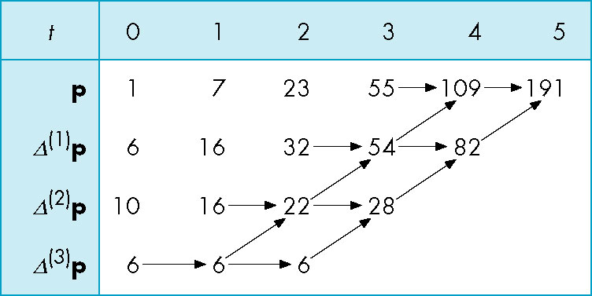
Finding the Next Values
Starting at the bottom, we can work up generating new values for the polynomial
Angel: Interactive Computer Graphics 5E © Addison-Wesley 2009

Slide 7
deCasteljau Recursion
We can use the convex hull property of Bezier curves to obtain an efficient recursive method that does not require any function evaluations
  Uses only the values at the control points
Based on the idea that “any polynomial and any part of a polynomial is a Bezier polynomial for properly chosen control data”
Angel: Interactive Computer Graphics 5E © Addison-Wesley 2009

Slide 8
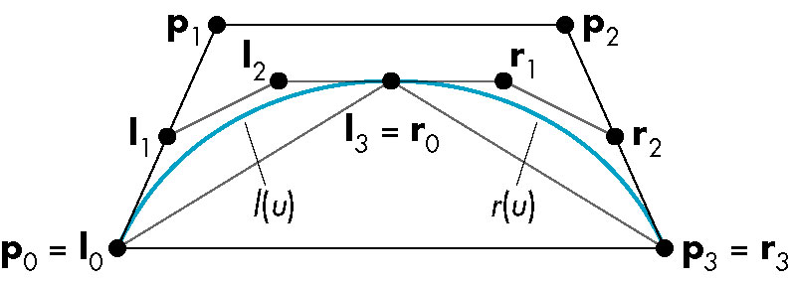
Splitting a Cubic Bezier
p₀, p₁ , p₂ , p₃ determine a cubic Bezier polynomial
and its convex hull
Consider left half l(u) and right half r(u)
Angel: Interactive Computer Graphics 5E © Addison-Wesley 2009

Slide 9
l(u) and r(u)
Since l(u) and r(u) are Bezier curves, we should be able to
find two sets of control points {l₀, l₁, l₂, l₃} and {r₀, r₁, r₂, r₃}
that determine them
Angel: Interactive Computer Graphics 5E © Addison-Wesley 2009

Slide 10
Convex Hulls
{l₀, l₁, l₂, l₃} and {r₀, r₁, r₂, r₃}each have a convex hull that
that is closer to p(u) than the convex hull of {p₀, p₁, p₂, p₃}
This is known as the variation diminishing property.
The polyline from l₀ to l₃ (= r₀) to r₃ is an approximation
to p(u). Repeating recursively we get better approximations.
Angel: Interactive Computer Graphics 5E © Addison-Wesley 2009

Slide 11
Equations
Start with Bezier equations p(u)=u^{T}M_{B}p
l(u) must interpolate p(0) and p(1/2)
l(0) = l₀ = p₀
l(1) = l₃ = p(1/2) = 1/8( p₀ +3 p₁ +3 p₂ + p₃ )
Matching slopes, taking into account that l(u) and r(u)
only go over half the distance as p(u)
l’(0) = 3(l₁ - l₀) = p’(0) = 3/2(p₁ - p₀ )
l’(1) = 3(l₃ – l₂) = p’(1/2) = 3/8(- p₀ - p₁+ p₂ + p₃)
Symmetric equations hold for r(u)
Angel: Interactive Computer Graphics 5E © Addison-Wesley 2009

Slide 12
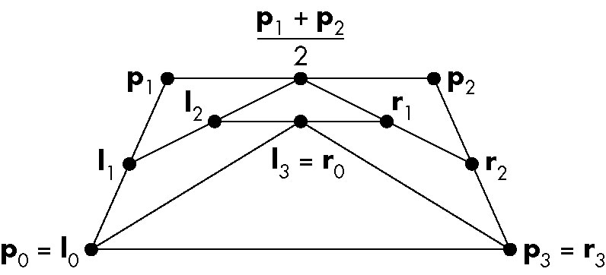
Efficient Form
l₀ = p₀
r₃ = p₃
l₁ = ½(p₀ + p₁)
r₁ = ½(p₂ + p₃)
l₂ = ½(l₁ + ½( p₁ + p₂))
r₁ = ½(r₂ + ½( p₁ + p₂))
l₃ = r₀ = ½(l₂ + r₁)
Requires only shifts and adds!
Angel: Interactive Computer Graphics 5E © Addison-Wesley 2009

Slide 13
Every Curve is a Bezier Curve
We can render a given polynomial using the recursive method if we find control points for its representation as a Bezier curve
Suppose that p(u) is given as an interpolating curve with control points q
There exist Bezier control points p such that
Equating and solving, we find p=M_{B}⁻¹M_{I}
p(u)=u^{T}M_{I}q
p(u)=u^{T}M_{B}p
Angel: Interactive Computer Graphics 5E © Addison-Wesley 2009

Slide 14
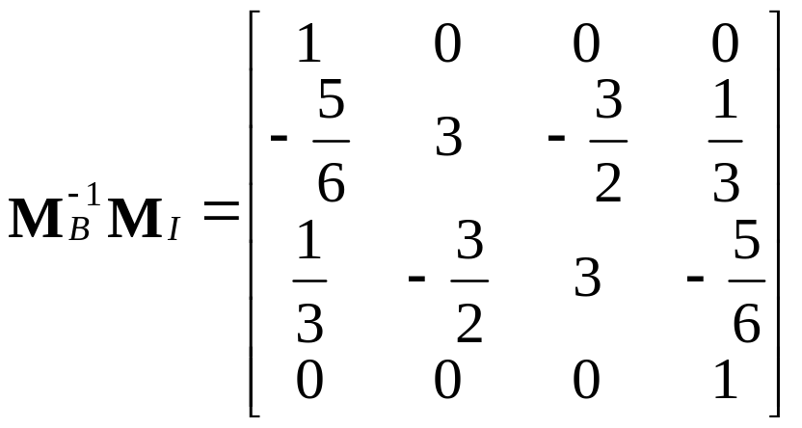
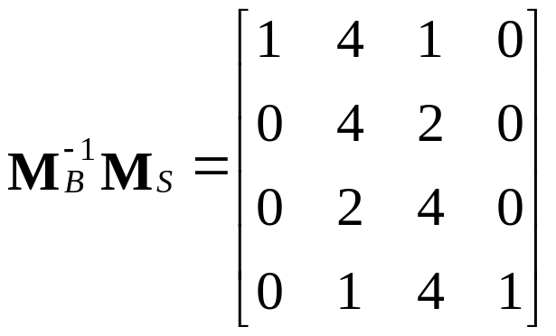
Matrices
Interpolating to Bezier
B-Spline to Bezier
Angel: Interactive Computer Graphics 5E © Addison-Wesley 2009

Slide 15
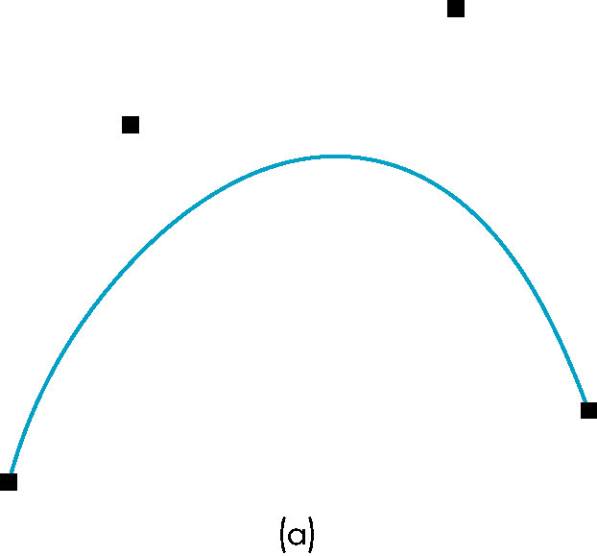
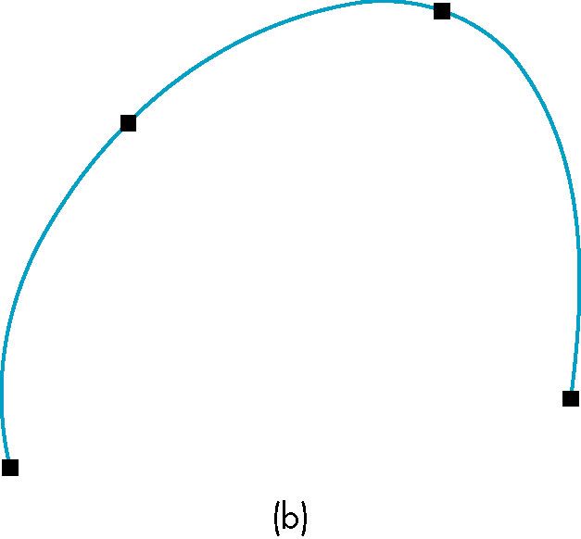
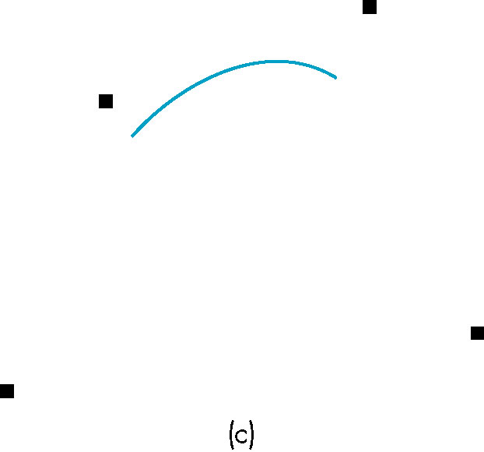
Example
These three curves were all generated from the same
original data using Bezier recursion by converting all
control point data to Bezier control points
Bezier
Interpolating
B Spline
Angel: Interactive Computer Graphics 5E © Addison-Wesley 2009

Slide 16
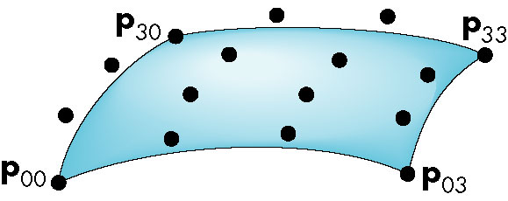
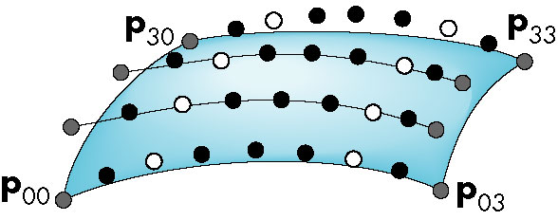
Surfaces
Can apply the recursive method to surfaces if we recall that for a Bezier patch curves of constant u (or v) are Bezier curves in u (or v)
First subdivide in u
  Process creates new points
  Some of the original points are discarded
original and discarded
original and kept
new
Angel: Interactive Computer Graphics 5E © Addison-Wesley 2009

Slide 17
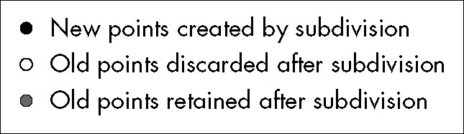
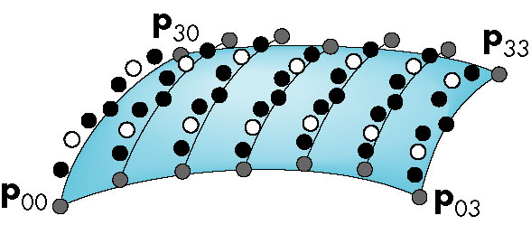
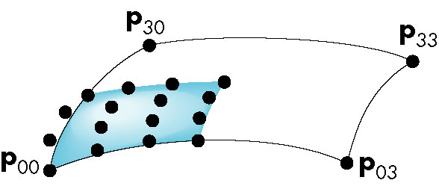
Second Subdivision
16 final points for
1 of 4 patches created
Angel: Interactive Computer Graphics 5E © Addison-Wesley 2009

Slide 18
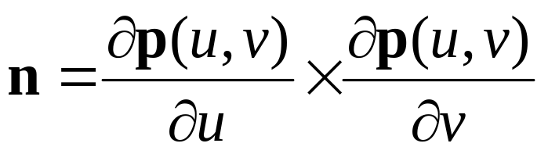
Normals
For rendering we need the normals if we want to shade
  Can compute from parametric equations
  Can use vertices of corner points to determine
  OpenGL can compute automatically
Angel: Interactive Computer Graphics 5E © Addison-Wesley 2009

Slide 19
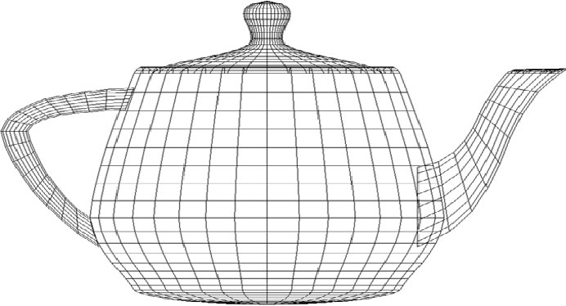
Utah Teapot
Most famous data set in computer graphics
Widely available as a list of 306 3D vertices and the indices that define 32 Bezier patches
Angel: Interactive Computer Graphics 5E © Addison-Wesley 2009

Slide 20
Quadrics
Any quadric can be written as the quadratic form
p^{T}Ap+b^{T}p+c=0 where p=[x, y, z]^{T}
with A, b and c giving the coefficients
Render by ray casting
  Intersect with parametric ray p(α)=p₀+αd that passes through a pixel
  Yields a scalar quadratic equation
    No solution: ray misses quadric
    One solution: ray tangent to quadric
    Two solutions: entry and exit points
Angel: Interactive Computer Graphics 5E © Addison-Wesley 2009

